Slide 1
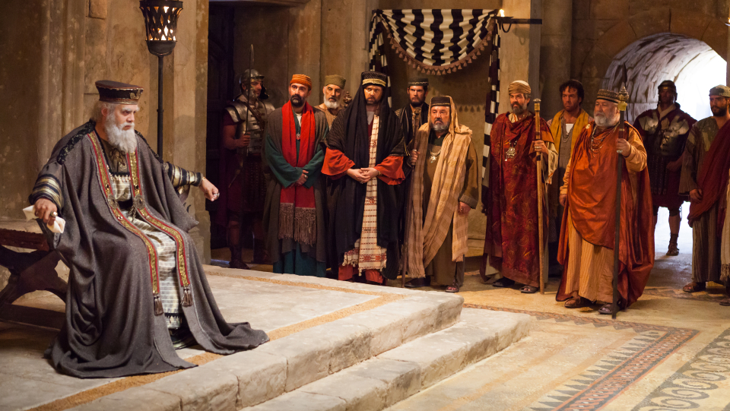
Wise Men & A Foolish King

Slide 2

Wise Men, Herod, & the Hebrew Bible

Slide 3
Wise Men, Herod, & the Hebrew Bible
Matthew’s account has heavy emphasis on fulfilled prophecy
Jews would have recognized his style mimicking Hebrew Bible
Opening line, “The genealogy of Jesus,” corresponds to Genesis
Genealogies were of great importance in Hebrew Bible

Slide 4
Wise Men, Herod, & the Hebrew Bible
Matthew’s account has heavy emphasis on fulfilled prophecy
The wise men “from the east” is significant
Not to pinpoint geographic location
Reversal of the problems in Genesis
Adam, Eve, Cain sent east after sin
Mimicking Abram’s journey from the east
Wise men begin demonstrating prophecies being fulfilled
Specifically: Gifts of gold and frankincense

Slide 5
May the kings of Tarshish and of the coastlands render him tribute; may the kings of Sheba and Seba bring gifts! May all kings fall down before him, all nations serve him – Psalm 72:10-11
Arise, shine, for your light has come, and the glory of the Lord has risen upon you. For behold, darkness shall cover the earth, and thick darkness the peoples; but the Lord will arise upon you, and his glory will be seen upon you. And nations shall come to your light, and kings to the brightness of your rising. Lift up your eyes all around, and see; they all gather together, they come to you; your sons shall come from afar, and your daughters shall be carried on the hip. Then you shall see and be radiant; your heart shall thrill and exult, because the abundance of the sea shall be turned to you, the wealth of the nations shall come to you. A multitude of camels shall cover you, the young camels of Midian and Ephah; all those from Sheba shall come. They shall bring gold and frankincense, and shall bring good news, the praises of the Lord. – Isaiah 60:1-6

Slide 6
Wise Men, Herod, & the Hebrew Bible
Herod’s connection to Hebrew Bible also emphasized
Unfamiliar with it; had to call the religious experts
Hears Micah’s prophecy about the King of the Jews (Matt. 2:6)

Slide 7
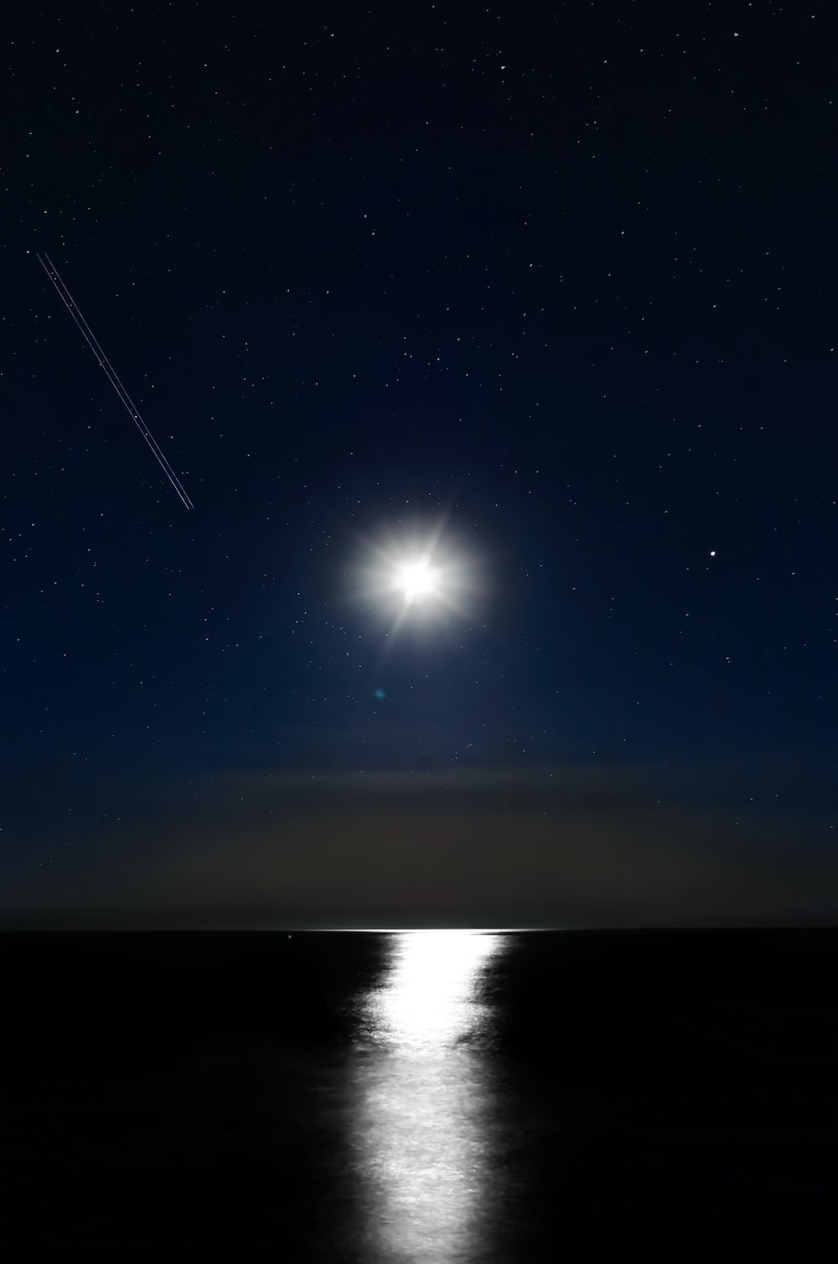
Reactions

Slide 8
Reactions
The Sign of His Birth
Wise men see visible sign in the sky that the King has been born
Fits the light motif beginning in Genesis 1 through Jesus’ “I Am the Light”
Herod is kept in the dark
“King of the Jews” in the “City of God” has understanding darkened
Chief priests and scribes recognize prophecy, but not the fulfilment
And this is the judgment: the light has come into the world, and people loved the darkness rather than the light because their works were evil – John 3:19

Slide 9
Reactions
The Sign of His Birth
Feelings About His Birth
The wise men are overcome with joy (9-10)
Herod is troubled (emotionally agitated) due to perceived threat (3)

Slide 10
Reactions
The Sign of His Birth
Feelings About His Birth
Reactions to His Birth
Wise men fall down and worship (11)
First humans specifically said to worship Jesus
The nations are coming to Him
Herod states he wants to worship
He was the serpent seeking to deceive with a lie to stop God’s plan
Jesus saved in a reverse exodus

Slide 11
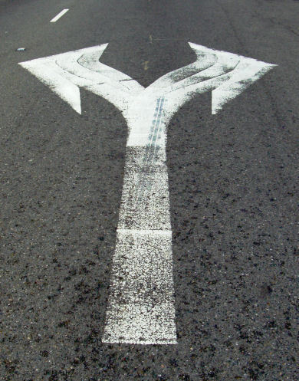
The Choice
Come “From the East”
Trust What God has Shown
Accept with Joy
Fall Down and Worship
Refuse to Change
Find God’s Message Troubling
Reject Him
Follow Course of Destruction

Slide 12
Which Will it Be?

